Slide 1



Basic Details of the team
and Problem statement
codingninjas
IDEA-THON 1.0
Problem Statement:
In traditional surveillance systems, manual monitoring by human operators leads to inefficiencies, delayed responses, and a lack of real-time detection and notification of suspicious activities.
There is a need for an AI-based intelligent camera decision-making system that can analyze video data in real-time, identify suspicious objects, gestures, gatherings, and notify users and nearby police stations with customizable response options.
Team Name:
Code Quad
Team Leader Name:
Aastha Prakash
Team Members’ Names:
Mehwish Khan
Anika Lohia
Jahanvi Singh
Institute Name:
Shri Ramswaroop Memorial College of Engineering and Management
Theme Name:
Open Innovation

Slide 2











Solution Details:
Solution Overview:
Introduce an AI-based intelligent camera decision-making system.
Emphasize real-time detection and notification of suspicious activities.
Key Components:
Surveillance Cameras
AI and ML Algorithms
Notification System
Functionality:
AI analyzes video data in real-time.
Identifies suspicious objects, gestures, unusual gatherings, and criminal faces and also identifies specific words spoken.
Notifies users and police stations with customizable response options.
Customizable Response:
Users choose to ignore, notify the nearest police station, or enable automatic notifications for all suspicious activities.
Technologies Used:

Slide 3
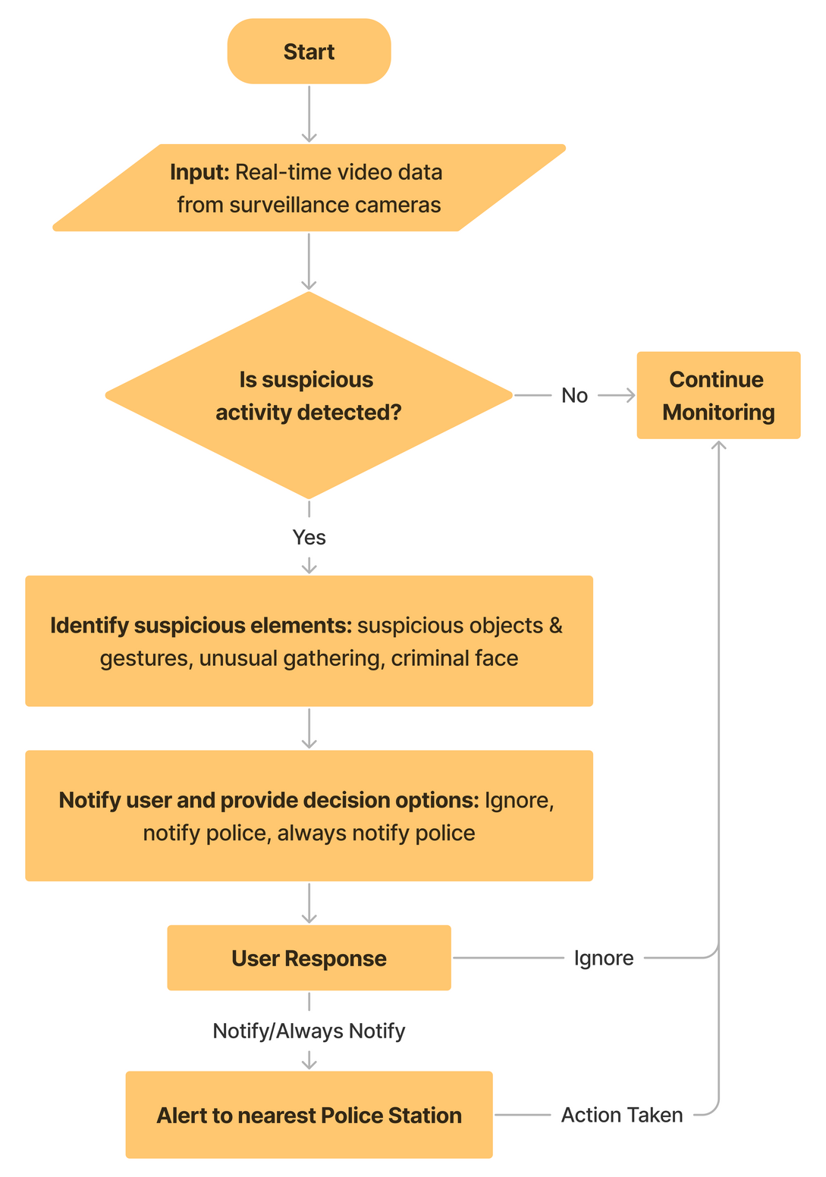
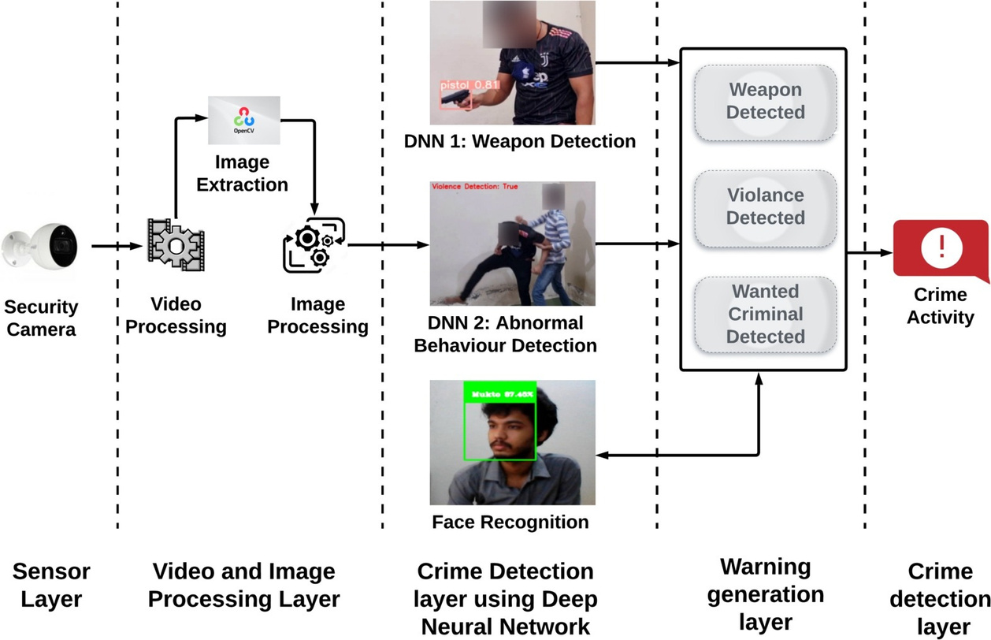
Flowchart & Use case:

Slide 4
Implementation Plan:
Dependencies:
Integrate surveillance cameras with AI & ML algorithms.
Develop a user-friendly interface for notification options.
Connect with police station systems for coordinated response.
Availability of sufficient and diverse training data
Access to Surveillance Infrastructure
Integration with Police Systems
Adequate technological infrastructure
Compliance with privacy regulations and legal requirements
Benefits:
Enhanced surveillance efficiency.
Real-time threat detection.
Faster response times to potential threats.
Data-driven decision making.
Show Stoppers:
Technological constraints
Legal or compliance issues
Resource Shortages

